Slide 1
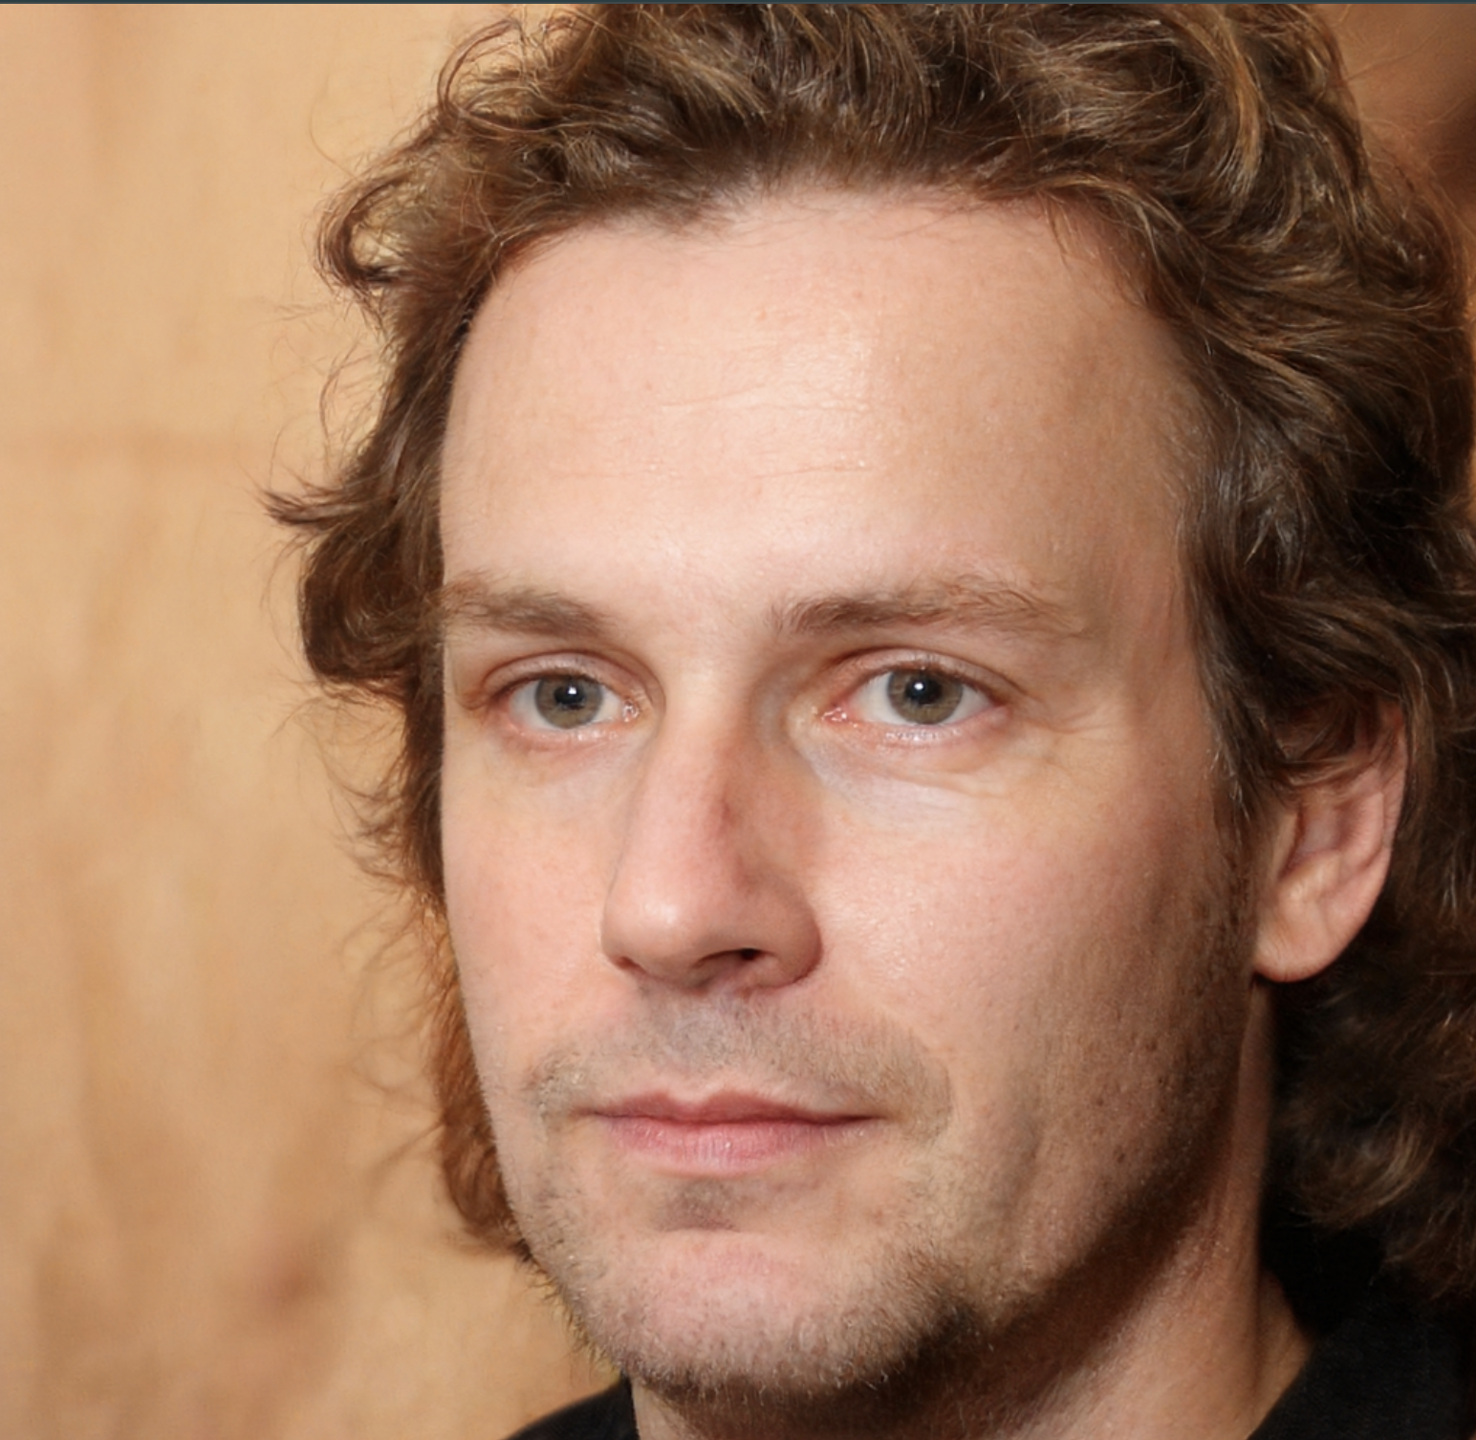

Fake/Real Face Classification
Nickolas Bleykhman, Kensho Pilkey, Raheq Hassan, Kamal Deep Vasireddy, Kenneth Roberts
Notes:
Hi everyone. Today, we’re going to talk about a project that focuses on detecting fake faces, specifically, those created by AI, known as deepfakes.
This tool helps us tell whether a face is real or generated, and the goal is to make this detection simple and accessible.

Slide 2
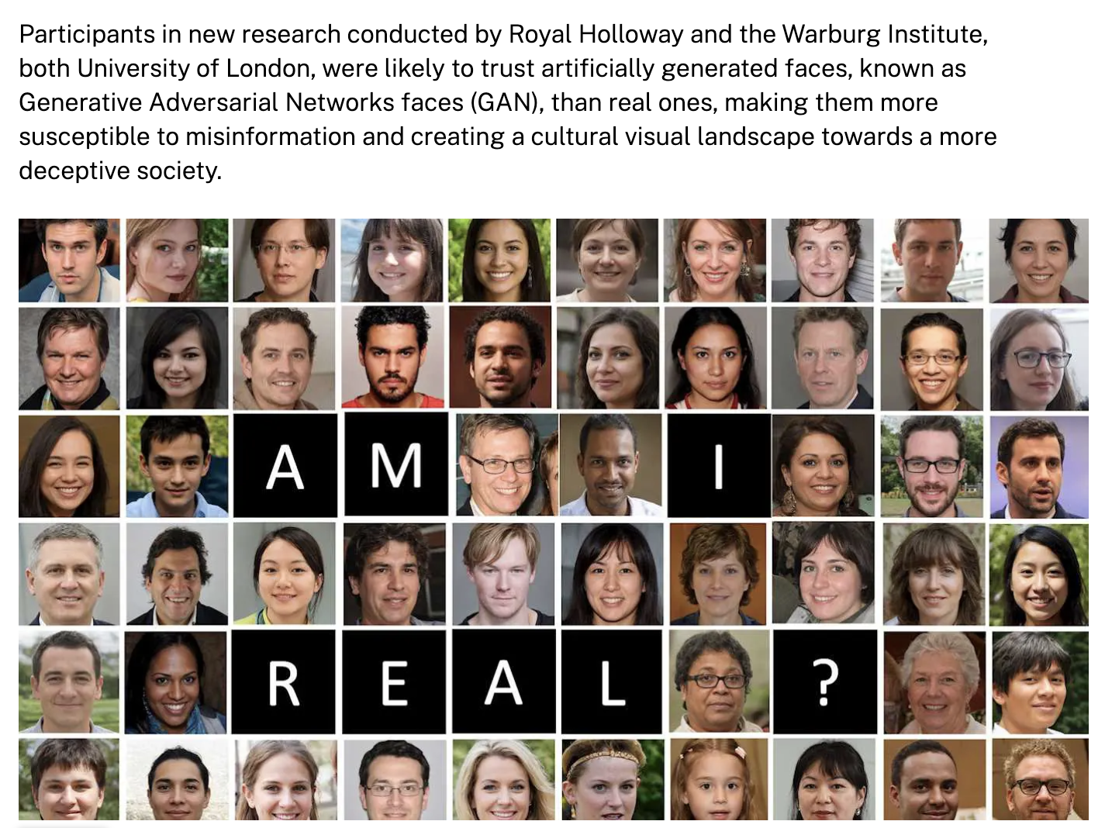
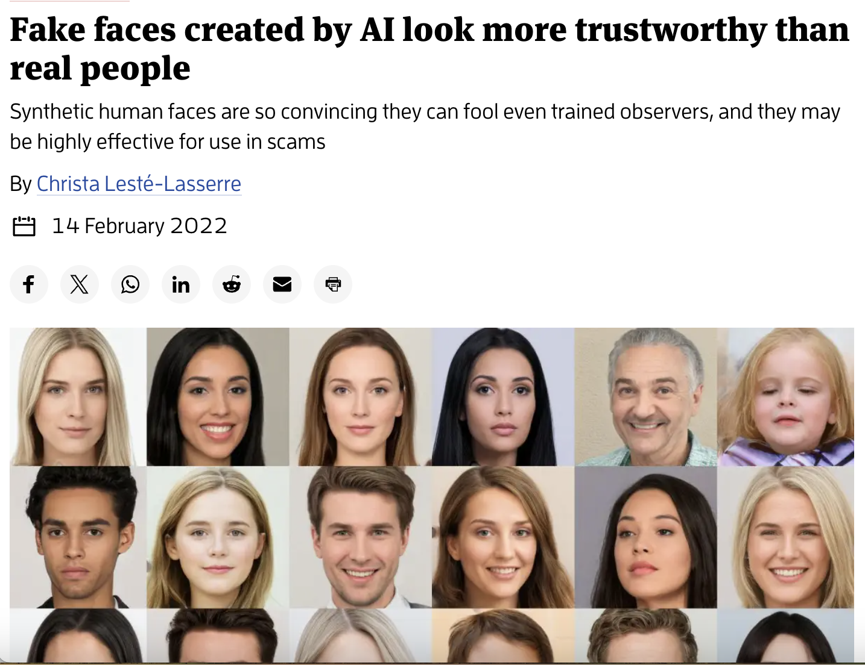
Introduction/Motivation
Problem:
High-fidelity generative models (StyleGAN, diffusion) makes distinguishing real faces from AI-generated headshots critical
Implications span misinformation, identity theft, and media authenticity
Objective:
To develop a fast, reliable, and user-friendly web application that can help individuals and organizations detect deep fake content before it spreads.
Lots of Related Work on the Topic, Namely:
GAN Artifact Detection: Marra et al. propose frequency analysis to spot GAN upsampling traces (Marra et al., 2019) [DOI:10.3390/app9071464]
Diffusion Model Forensics: Yu et al. use texture and noise statistics to uncover diffusion synthesis anomalies (Yu et al., 2022) [arXiv:2203.14103].
Notes:
We’re building this because deepfakes are getting really good, so good that it’s hard to tell what’s real and what’s fake anymore. People are starting to trust AI-generated faces more than real ones, which makes it easier for fake content to spread. This can lead to big problems, like spreading false information, scamming people, and hurting trust in media and news.
Our goal is to create a tool that helps people quickly and easily check if a face is fake, so we can stop misinformation before it spreads. It’s designed to be fast and simple, so anyone can use it.

Slide 3

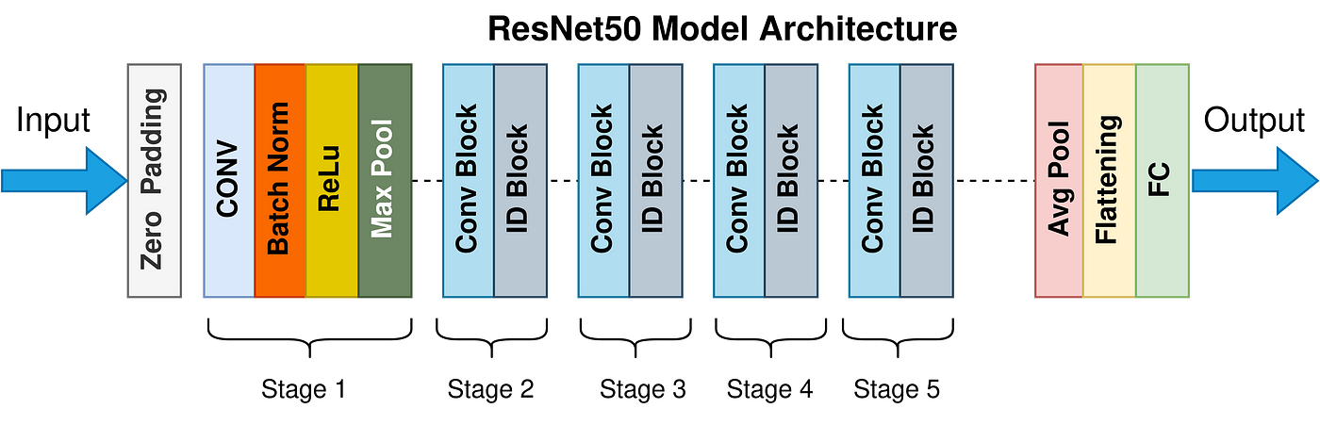
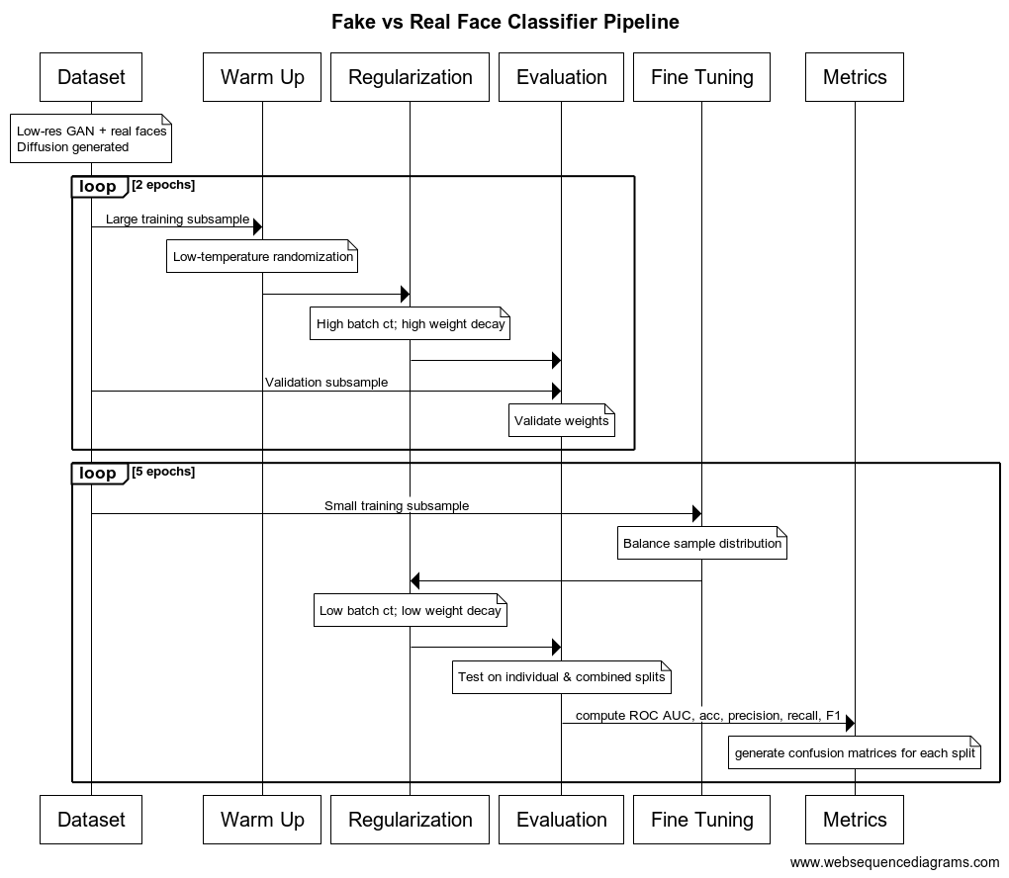
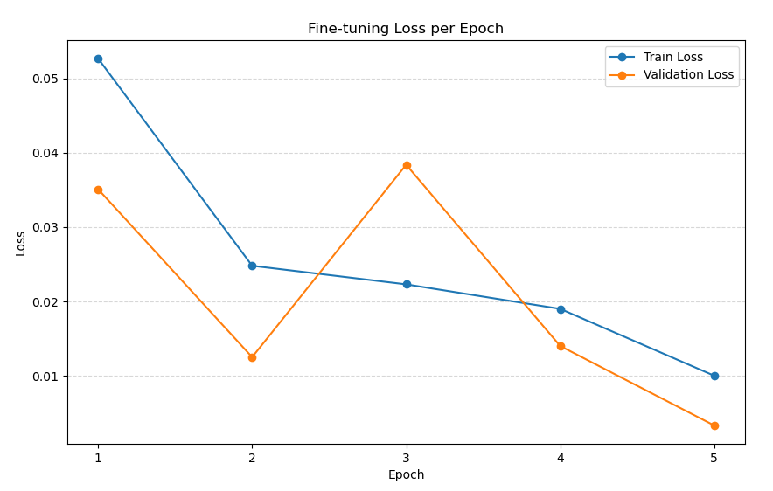
Methods & Experimental Design
ResNet50 Architecture
Notes:
Data Collection and Preprocessing:
140K Real vs Fake Faces: 140,000 low-res (256x256) real vs GAN fake faces (Kaggle)
TPDNE: 20,000 high-res (1024x1024) diffusion-synthetic headshots
FFHQ: real headshots for additional variability
Split: 70% train, 15% validation, 15% test
Model Pipeline using RTX 5090:
Pre-training on low-res GAN data (ResNet-50 + aggressive augmentations: crops, blur, color jitter, erasing
Fine-Tuning jointly on high-res TPDNE + 140K splits balancing sampling and stronger noise
Regularization: weight decay, warm-up scheduler, ReduceLROnPlateau policy
Evaluation Protocol:
Metrics: ROC, AUC, accuracy, precision, recall, F1-score
Confusion matrices on individual and combined testes

Slide 4
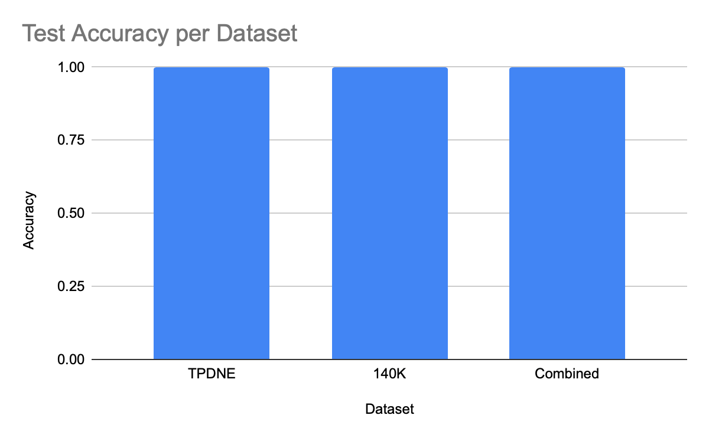
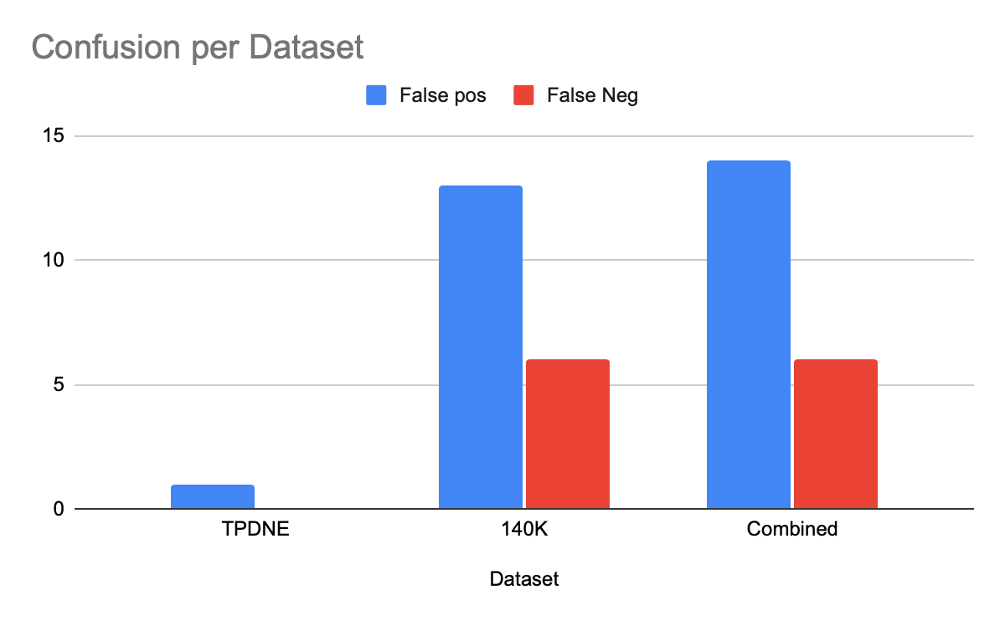
Results and Conclusions
TPDNE Test: 1 misclass of 3,000 images
140K Test: 19 misclass of 20,000 images
Combined Test: 20 misclass over 23,000 images
Precision & recall > 0.98 splits
Combined:
14 false positives
6 false negatives
Future Work
Fine-tune with samples on ResNet-101
Fine-tune and experiment with Dall-E sample set

Slide 5



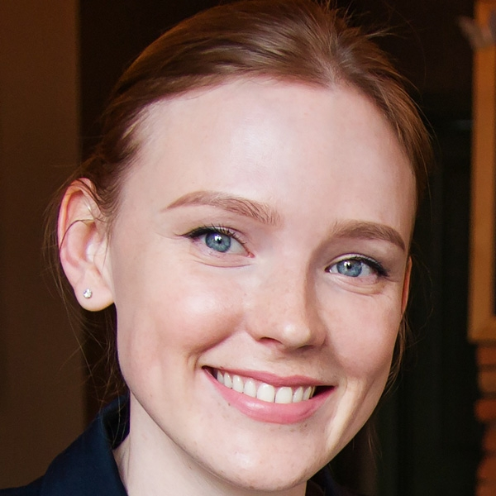
Live Demo

